Slide 1




Slide 2

The money you donate
supports our 34 partner agencies
in their mission to
Improve Lives
and assure fair access to
Health Care, Education and
Financial Stability
in Centre County.

Slide 3
These are the agencies you support …

Slide 4

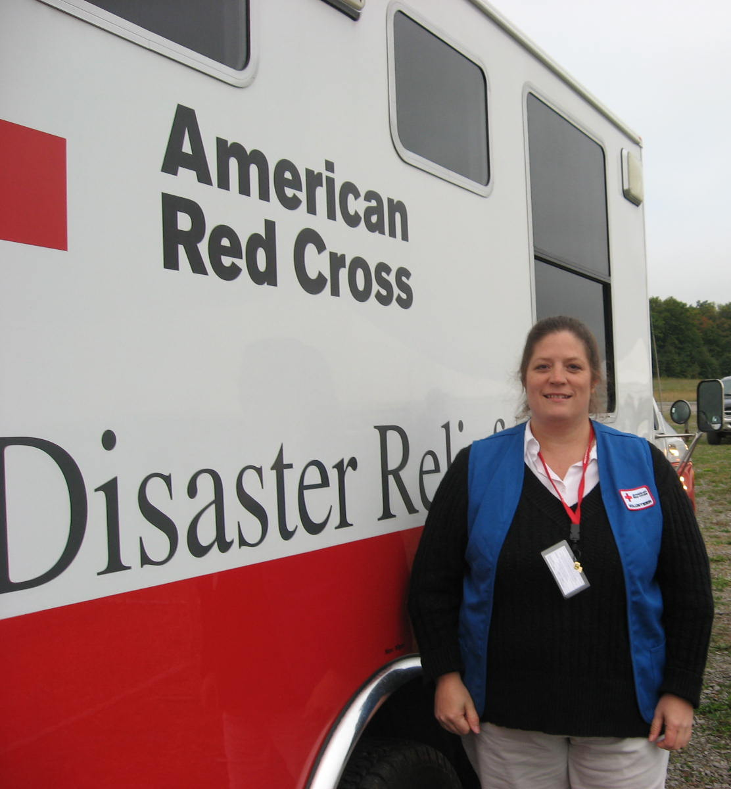
Prevent, Prepare,
Respond To Emergencies

Slide 5
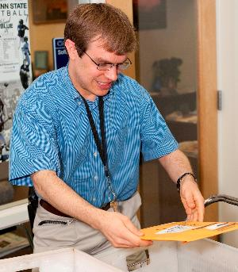

Adults Moving Forward – Enhancing Lives

Slide 6




Slide 7



Slide 8

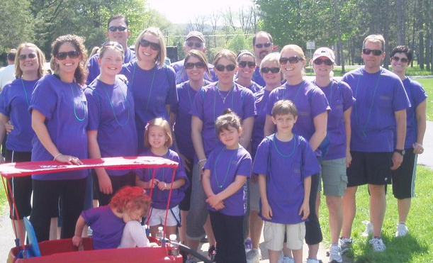
Prevents Homelessness for Women & Children

Slide 9

Catholic Charities
Providing Help. Creating Hope.

Slide 10

Center for Alternatives
in Community Justice
Building Unity
Resolving Conflict
Restoring Justice

Slide 11
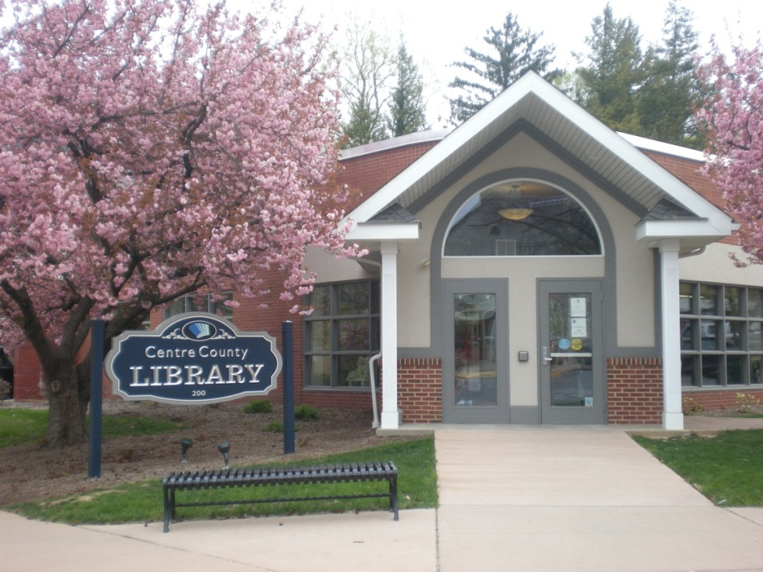

Connecting Information, Recreation, Technology and Community

Slide 12


Empowering survivors of sexual or domestic violence
A safe environment for custody exchange and supervised visits.

Slide 13

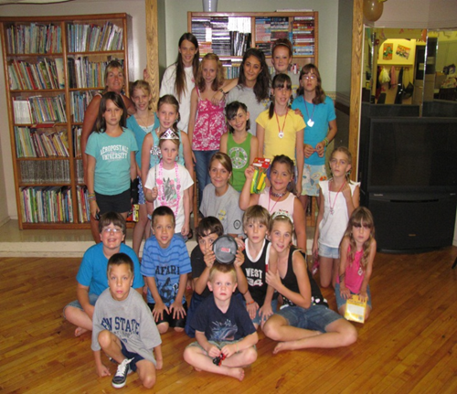
Youth Service Bureau
Friendship
Security
Mentoring
Learning
Opportunities

Slide 14
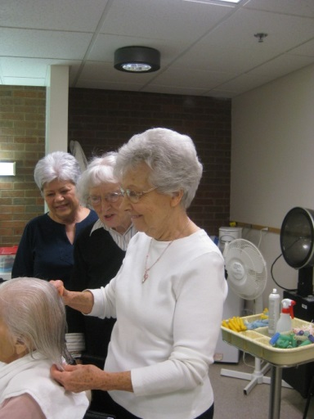
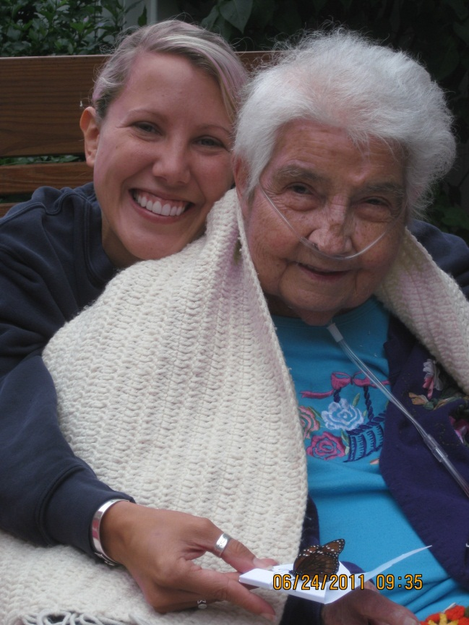
CENTRE CREST AUXILIARY
LOVING
CARING
GIVING
IMPROVING
ENHANCING

Slide 15


Centre HomeCare, Inc.
A Home Health Care Agency
Compassion.
Security.
Quality Care.

Slide 16

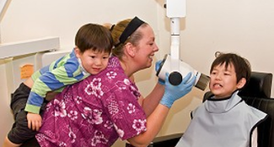
Programs and Advocacy for the Medically Underserved

Slide 17
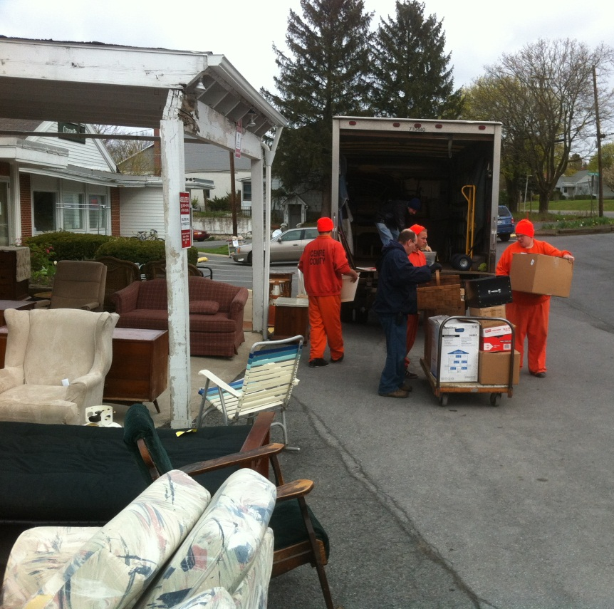
CentrePeace, Inc.
Restoring Furniture,
Restoring LIVES.

Slide 18
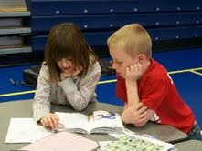
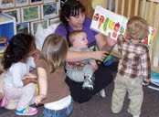
Child Development & Family Council
Early Learning Changes Our Future

Slide 19
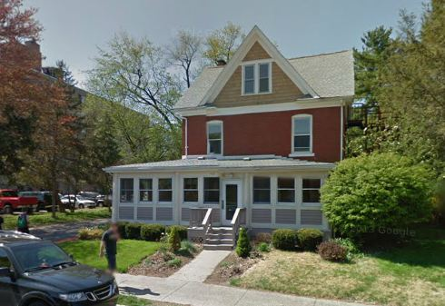

Community Help Centre “Heroes”
For Any Problem, Any Time

Slide 20

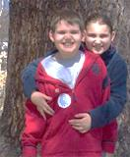
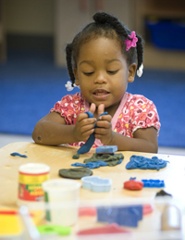
Help
Hope
Answers
Inclusion
Vision

Slide 21

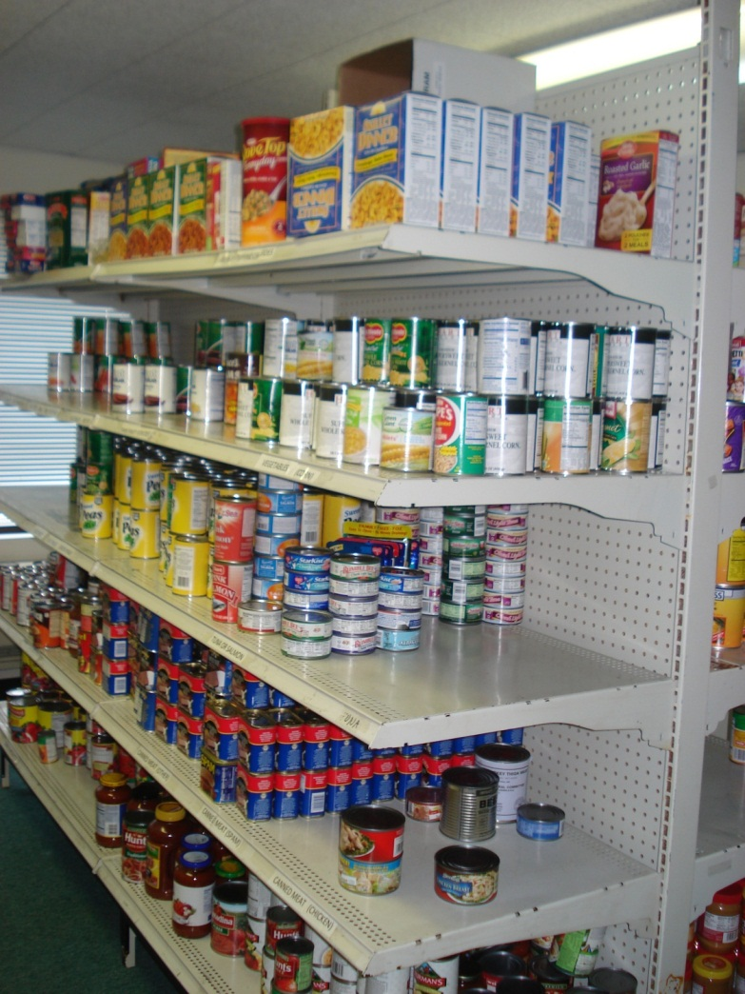
Peace Begins When The Hungry Are Fed

Slide 22

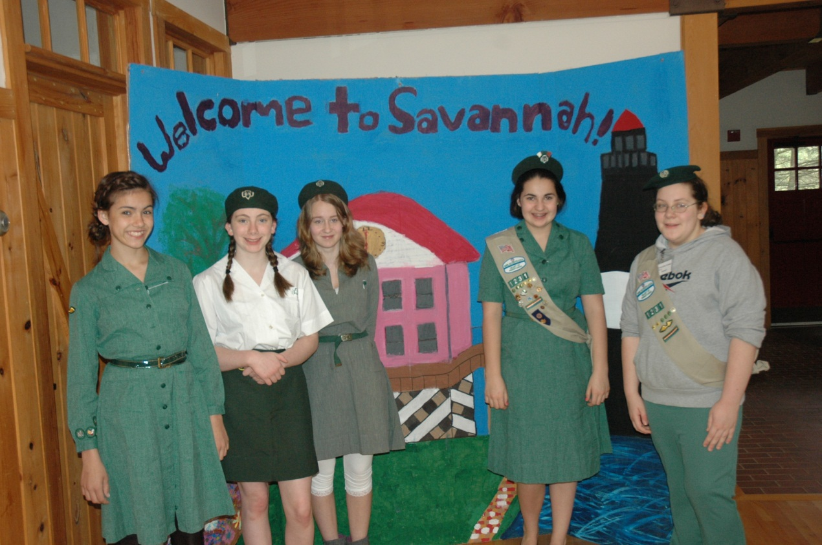
Building
LEADERSHIP
COURAGE
CONFIDENCE
and
CHARACTER

Slide 23
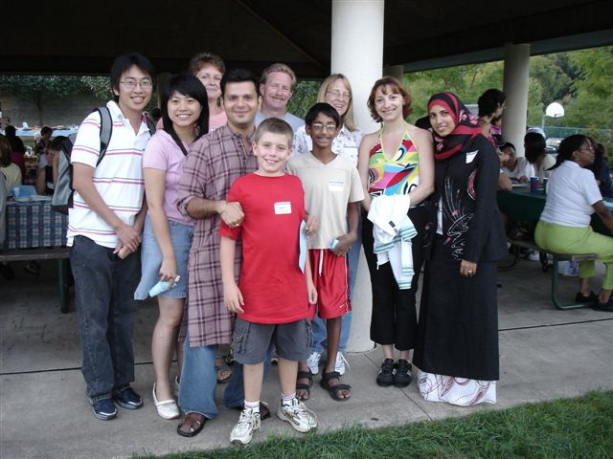

Building Community Across Cultures.

Slide 24

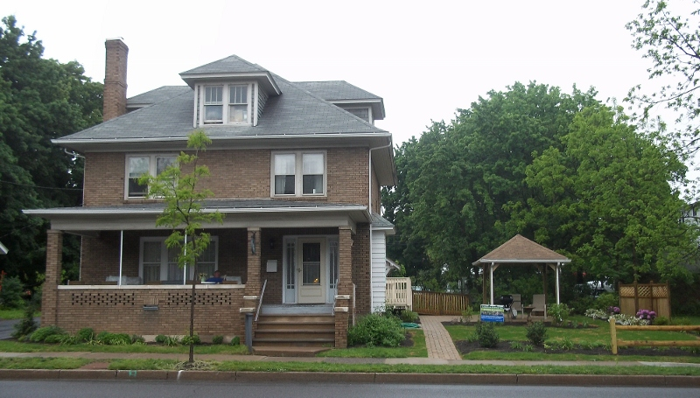
The House of Care
A Home with a Heart

Slide 25

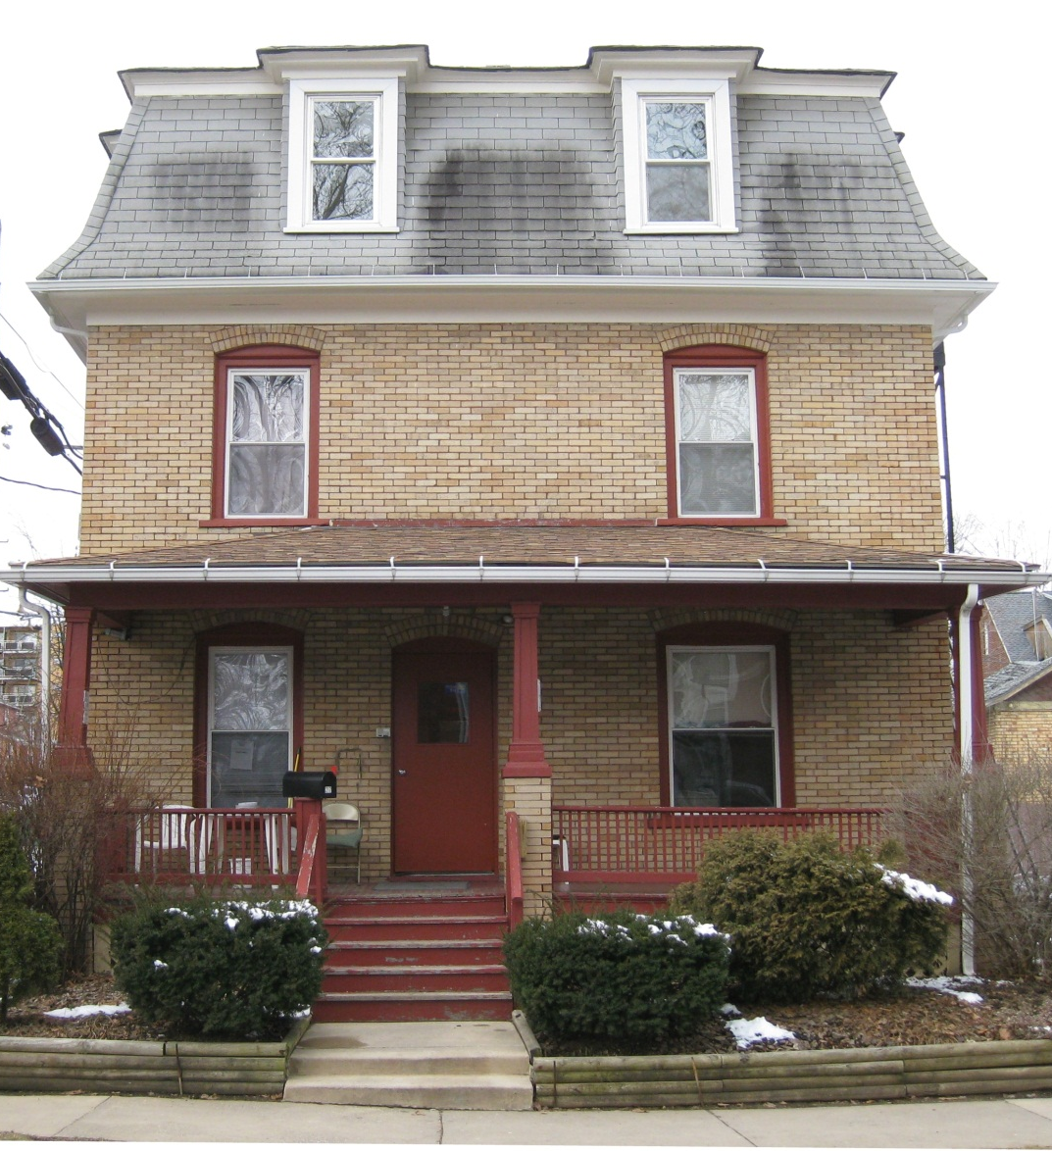
Shelter.
Guidance.
Hope.
Self-sufficiency.

Slide 26

Congregations helping neighbors in need.

Slide 27

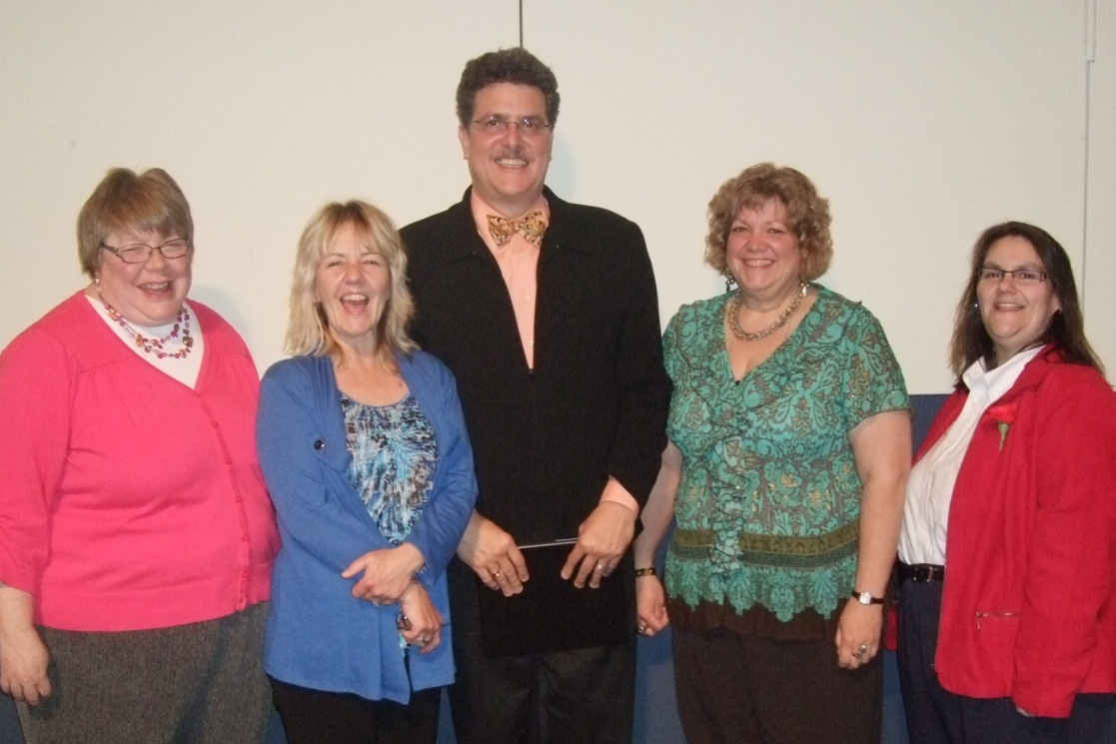
Justice
Advocacy
Protection
Equality
Stability

Slide 28

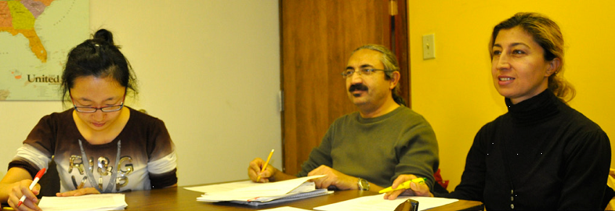
Uplifting our Community
through Literacy and Learning

Slide 29
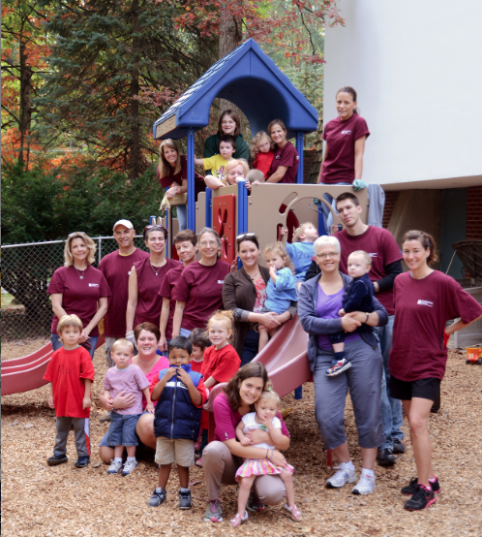

PARK FOREST DAY NURSERY PRESCHOOL
Making a Difference
In Children’s Lives

Slide 30

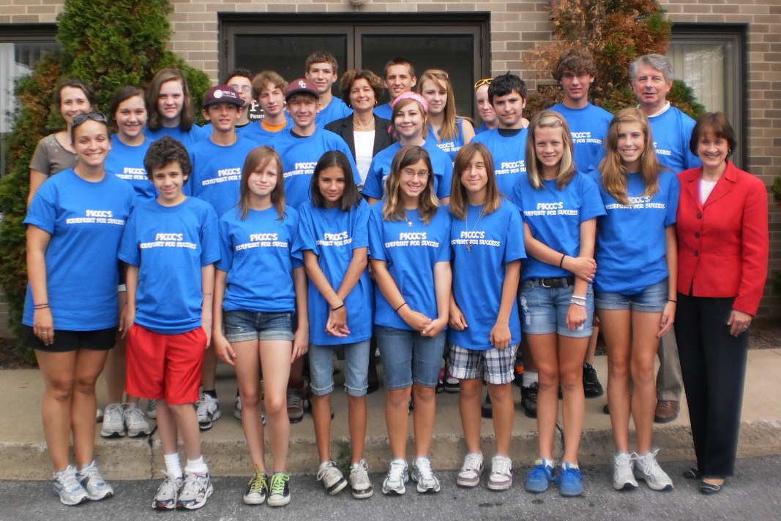
Career exploration for youth

Slide 31


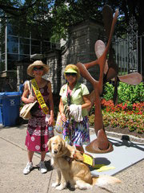
Independence through Support, Education, Referral and Technology

Slide 32


Opportunity Choice
Support
Recovery

Slide 33

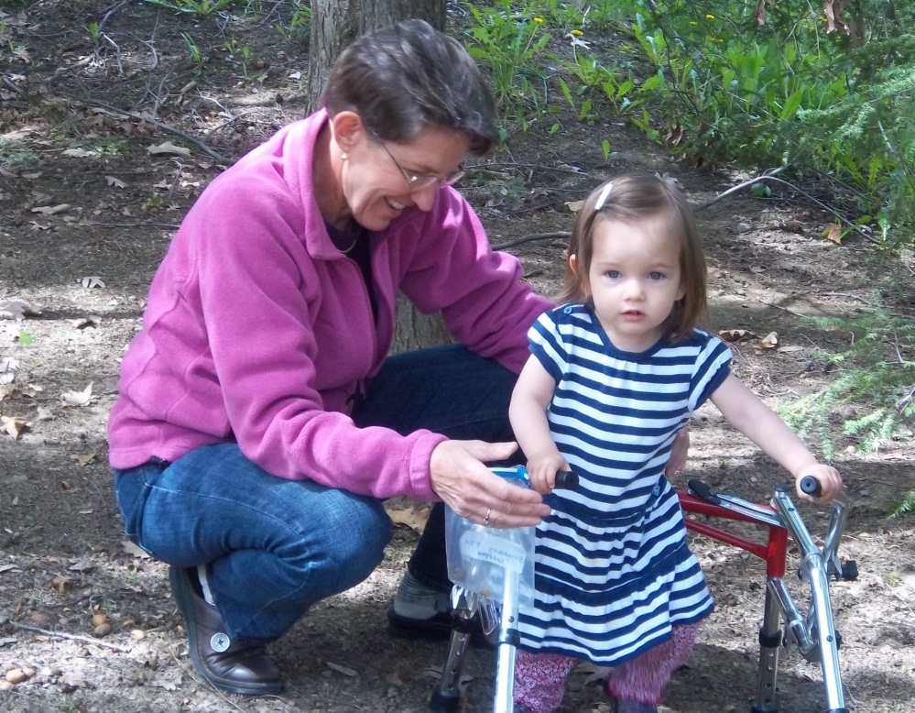
Programs For Persons With Disabilities

Slide 34

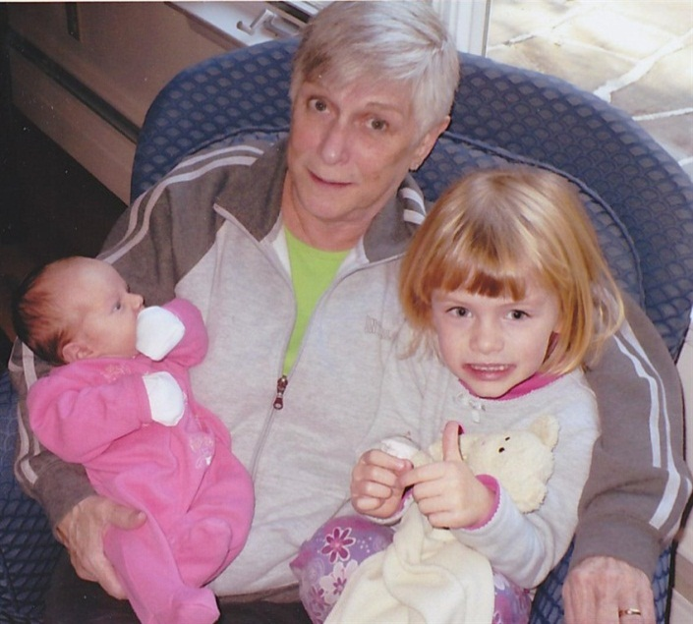
Sharing grief in a supportive setting.

Slide 35


Slide 36

THANK YOU for your support of the
2014 Centre County United Way Campaign
and the incredible work being done in
our community by our partner agencies.

